Slide 1
Dial in: 1-914-614-3221
Access Code: 951-538-621
Slides in “Handout” Tab
VA and the Cooperative Research Provision
(Single IRB Requirement)
March, 2020 Support Session on VA’s Implementation
Sarah Rule, MPH, CCRP
Senior Regulatory Affairs Officer, ORPP&E
VHA Office of Research & Development
March 3, 2020

Slide 2
Topics
  Summary monthly statistics for exception and IRB reliance requests received and processed by ORD
  Applying the cooperative research provision (single IRB requirement): questions received and answered by ORD
  Application process for VA Facilities to request an exception from the cooperative research provision (single IRB requirement) or to request a change in IRB arrangements
    Common Mistakes
    Helpful Tips to Facilitate Completion of Application and Processing by ORD

Slide 3

Where Are We – March, 2020
September 2016
January 19, 2017
January 23, 2018
June 19, 2018
July 19, 2018
January 21, 2019
January 19, 2018
Jan 20, 2020
NPRM
Final Rule revising the Common Rule
Original effective/
compliance date
Six month delay in effective date to July 19, 2018
Six month delay in compliance to January 21, 2019
Effective date –
Three burden-reducing provisions
Compliance date –
2018 Common Rule
Final Provision*
Compliance date
*38 CFR §16.114 – Cooperative Research Provision (also referred to as the “Single IRB Requirement”)

Slide 4
VA’s Implementation of the Cooperative Research Provision:
Key Data as of January 20, 2020
Questions related to determining whether the cooperative research provision (single IRB) apply
  Approximately 450 queries received
Exception Requests
  917 Requests received
IRB Reliance Requests
  3 Application Requests received

Slide 5
VA’s Implementation of the Cooperative Research Provision:
Exception to Single IRB Requirement Requests

Slide 6
Applying the Cooperative Research Provision
(Single IRB Requirement):
Major Categories of Questions Received by ORD
Applicability of cooperative research provision when:
  VA Facility is conducting research with its academic affiliated University
  VA is conducting industry-funded clinical trials
  VA is conducting DoD or NIH funded studies
Questions about interpretation of cooperative research provision based upon information from another VA Facility or University
Questions from Universities on how VA is implementing the cooperative research provision

Slide 7
When Does the Single IRB Requirement Apply to Human Subjects Research that are Conducted or Supported by the VA?
All VA Non-Exempt Human Subjects Research
All VA Non-Exempt Human Subjects Research With More than One Institution Engaged
All VA Exempt and Non-Exempt Human Subjects Research
All VA Non-Exempt Human Subjects Research With More than One Institution Engaged and the Other Institution(s) is a Federal Institution (including another VA Facility) or the other non-Federal Institution(s) is a Recipient of Federal Government Funding or Support for that Research Activity
Single IRB Required Unless Exception Applies

Slide 8
Key Questions to Ask for Non-Exempt Human Subjects Studies that Follow the 2018 Requirements: Determining Whether the §.114 Cooperative Research Provision (Single IRB Requirement) Applies
Single IRB regulation does not apply
NO
Does the non-exempt human subjects research involve more than one engaged institution?
YES
Single IRB regulation does not apply
NO
Are any of the other participating institutions a Federal institution (including another VA) or are any of the participating institutions receiving federal funding or support for the research activity?
YES
Send an application to ORD for requesting approval of the single IRB for the study if an IRB Reliance Agreement or MOU is not present.
Does ORD policy allow the use of the single IRB for the study, has an exception to the single IRB requirement already been determined and documented, or will the single IRB allow the VA Facility to rely upon it for IRB review?
Send a request for an exception to the single IRB requirement to ORD and/or the applicable Federal agency or department.

Slide 9
Poll #1:
Applying the Single IRB Requirement
Answer Yes or No. A VA Investigator was awarded an NIH grant in 2015 to conduct a multi-site clinical trial. Six (6) VA Facilities were selected to participate in the study; the VA Central IRB is the IRB of Record for all six (6) VA Facilities and approved the study on January 3, 2016. The VA Central IRB has not transitioned the study to follow the 2018 Requirements.
A University is now being added as a participating site.
Question: Is a single IRB required for this NIH-funded study involving 6 VA Facilities and one University, unless an exception is approved?
Possible Answers:
1. Yes
2. No

Slide 10
Poll #2:
Applying the Single IRB Requirement
Answer Yes or No. A VA Investigator has been asked to be a participating VA site in a multi-site clinical trial sponsored and funded by an industry-collaborator. 14 Universities will also be participating. The Universities are using the commercial IRB that has been selected by the industry-collaborator.
Question: Is a single IRB required for this industry-funded clinical trial involving one VA Facility and 14 Universities, unless an exception is approved?
Possible Answers:
1. Yes
2. No

Slide 11
ORD Process for Requesting an Exception from the Single IRB Requirement for Cooperative Non-Exempt Human Subjects (CHNE) Studies
The exception request spreadsheet titled “PROSPECTIVE CHNE RESEARCH EXCEPTION REQUEST” must be sent to ORD by the ORD funding service, ACOS/R&D, AO/R&D, VA Human Research Protections Administrator or the VA Facility’s IRB Administrator.
Requests should be sent when the research plan is being developed and before IRB review.
Email subject line should reference that it is a request for single IRB exception with the name of the study and the VA Principal Investigator.
  Example: Request for sIRB exception: Comparison of X vs. Y, A. Investigator, M.D.
Requests are to be sent to: IRBRelianceandSIRBExceptions@va.gov.
Requests will be reviewed by ORD with an expected response time no later than 10 business days.

Slide 12
Exceptions to the Cooperative Research Provision
(Single IRB Requirement):
Application Process, Mistakes, Helpful Hints Studies
The exception application process for use of a single IRB is described on ORD’s website at https://www.research.va.gov/programs/orppe/single_irb.cfm.
The exception application form Prospective CHNE Research Exceptions Request located on the website must be used.
A valid justification must exist in order for ORD to grant an exception.

Slide 13
Examples of Rejected Justification Requests: Exception Requests
LEAD VA SITE, IF APPLICABLE, OR LOCAL SITE | VA Facility Street | VA Facility City | VA Facility State | VA Facility Zip Code | ACOS/R NAME, DEGREE(s) | ACOS/R EMAIL ADDRESS | LOCAL STUDY # (if applicable) | STUDY PI NAME | STUDY NAME | SPECIFIC FUNDING SOURCE | JUSTIFICATION
 |  |  |  |  |  | ABCD@va.gov | 12344 | Lee Recruit, MD | BEST-Real World Outcomes in Critical Limb Ischemia Registry | National Heart, Lung and Blood Institute | Our VA Facility will be the IRB of Record.
 |  |  |  |  |  | ABCD@va.gov | 12345 | Pam Researcher, MD | Effect of NMN Supplementation on Organ System Biology | Department of Defense | This study is greater than minimal risk with a sensitive study population

Slide 14
Helpful Tips to Completing the Prospective CHNE Research Exception Request Form
Be sure to complete all fields of the exception application spreadsheet.
An example is included in the exception application spreadsheet. Please delete the row (Row #2) prior to submitting the spreadsheet.
3. Include an award number, if known. A column is being added to
the exception application spreadsheet and will be updated on
the ORD website.
The justification field in the exception application spreadsheet needs to explain why use of a single IRB is not feasible or possible for the cooperative research activity. If you are unsure how to write the justification, please send a query to IRBRelianceandSIRBExceptions@va.gov.

Slide 15
IRB Reliance Requests:
Application Process, Mistakes, Helpful Hints
IRB Reliance requests require more information than exception requests for use of a single IRB for cooperative research.
The IRB Reliance request form: Institutional Review Board (IRB) Reliance Request Form is located on ORD’s website at https://www.research.va.gov/programs/orppe/single_irb.cfm.
Your VA Facility should not submit the IRB Reliance request form to rely upon another institution’s IRB without asking the other institution.
The Institutional Review Board Request Form is an application form. It is not a Memorandum of Understanding or IRB reliance agreement.
VA Facilities cannot enter into IRB reliance agreements at the current time using the SMART IRB reliance agreements.

Slide 16
Requesting Change in IRB Arrangements: The Institutional Review Board (IRB) Reliance Request Form https://www.research.va.gov/programs/orppe/single_irb.cfm

Slide 17
Tips to Complete the Institutional Review Board (IRB) Reliance Request Form
Use the Institutional Review Board (IRB) Reliance Request form to communicate early with the potential IRB you wish to rely.
Communicate with ORD and ORO early about potential changes in an IRB reliance relationship prior to submitting the IRB Reliance Request Form.
The IRB Reliance Request Form Question #7 asks: “Does the IRB identified currently hold an accreditation?” ORD does not require an IRB to be AAHRPP accredited to be an IRB for VA Facilities. ORD is capturing this data as a metric.
Please make sure any hyperlinks referenced in the application are working.
Attach the applicable supplemental documents requested with the IRB Reliance Request Form instead of sending a separate email if possible.

Slide 18
Tips to Complete the Institutional Review Board (IRB) Reliance Request Form (cont.)
Please remember that the IRB Reliance Request Form must be submitted by the VA Medical Center; it cannot be submitted by the ACOS/R&D or AO/R&D.
Send the IRB Reliance Request Form and questions to: IRBRelianceandSIRBExceptions@va.gov.

Slide 19
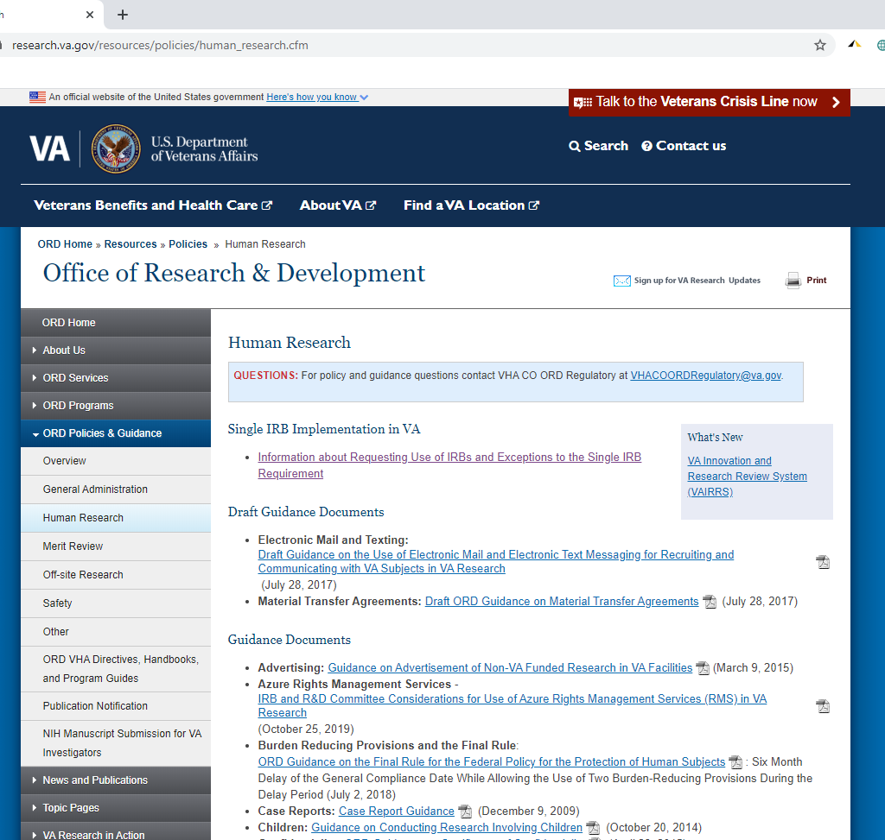
Information about ORD Website Single IRB Implementation in VA Available from ORD Policies and Guidance Webpage: https://www.research.va.gov/resources/policies/human_research.cfm

Slide 20
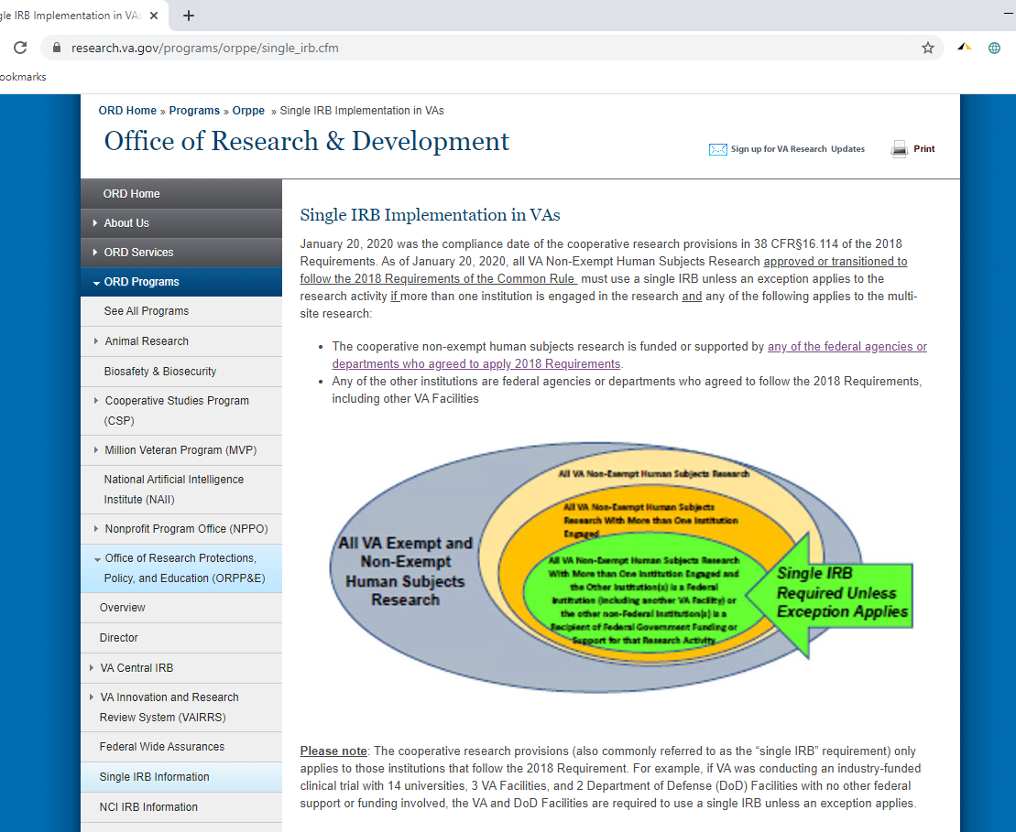
ORD’s Website for Information About Single IRB Implementation in VA https://www.research.va.gov/programs/orppe/single_irb.cfm

Slide 21
Questions?
Presenter:
Sarah Rule, MPH, CCRP at sarah.rule@va.gov
Send Questions to:
VHA IRB Reliance/Single IRB Exceptions Box at IRBRelianceandSIRBExceptions@va.gov

